Slide 1

Project Architecture
Eric Benfaida Mrinal Ghosh Unmol Gill Carmen Hurtado

Slide 2
Application Structure
User interface web application
User and Post classes and their interaction
Mean Squared Error (MSE) matching algorithm
Posting and account management tools

Slide 3
UI Design
The web application user interface was designed in HTML with Flask classes implemented in python to populate it
The following classes were created to provide most of the functionality:
RegistrationForm
Allows user sign up and saves data to database
LoginForm
Allows user login and validates credentials
RequestResetForm
Allows change of username or other account details
ResetPasswordForm
Allows change of password for registered account

Slide 4
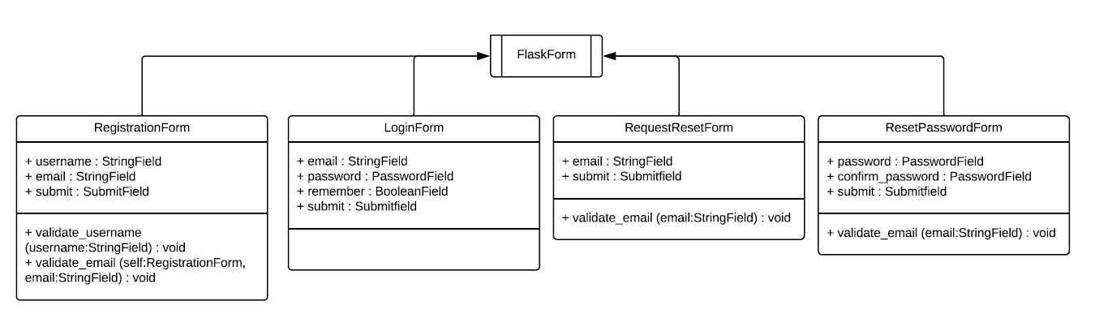
UML Diagrams for UI

Slide 5
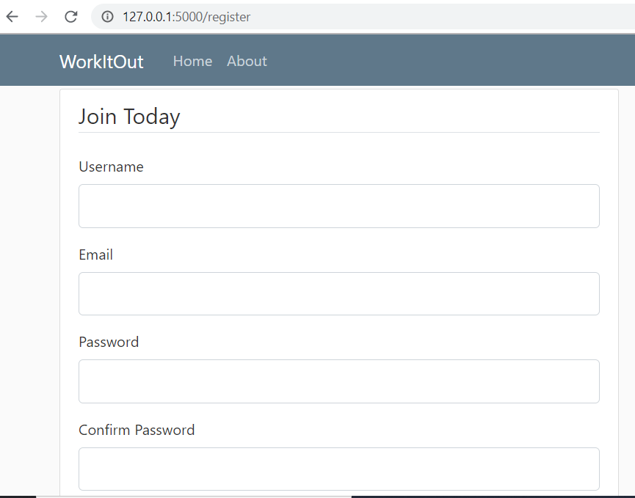
Account Sign Up

Slide 6
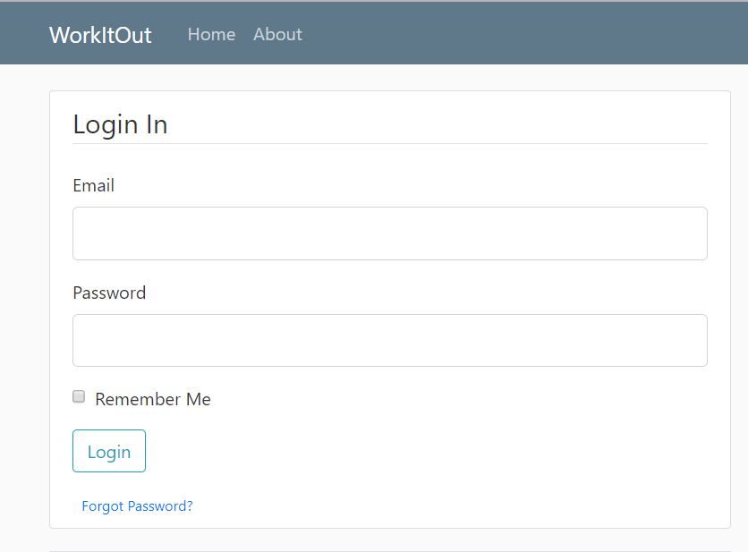
Account Login

Slide 7
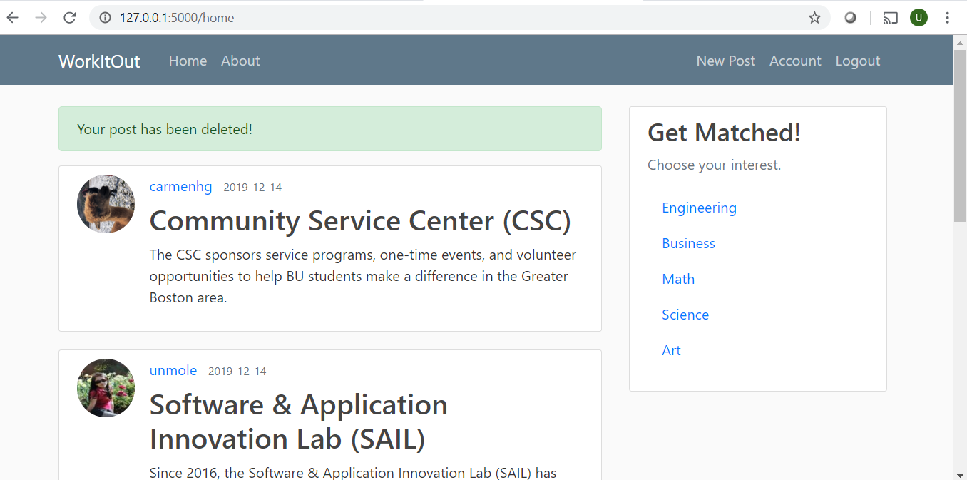
Post Stream Format

Slide 8
2. User & Post Classes
User is a class that contains all the attributes of the user
Post is a class that contains attributes for each post (initial or created) that is displayed on WorkItOut
Each post represents a project that users would like to collaborate on and holds a creator id as well as other users interested in working on it

Slide 9
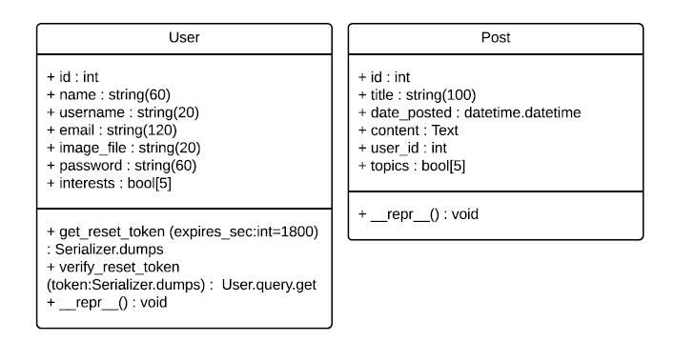
User & Post UML Diagrams

Slide 10
3. Matching Algorithm
Users are matched with each other (similar to tinder) as well as to projects they may be interested in
In order to achieve this, each user contains a boolean array which shows the topics they chose to be included in, like a tag
This tag array is compared to other users’ as well as projects’ in one of two ways:
Biased matching
Unbiased matching
A ranking of matches is created and shared with users on a suggestions page

Slide 11
Biased Algorithm
The basis for this algorithm is that similar topics are likely to have an overlap of interest
For example, a person interested in Science may be 0.5x interested in Math and 0.85x interested in Engineering
The process for finding a value for compatibility is:
(tag array1).(bias matrix).(tag array2) = compatibility
By maximizing this compatibility value, we can rank users based on compatibility relative to a single user using the mean squared error

Slide 12
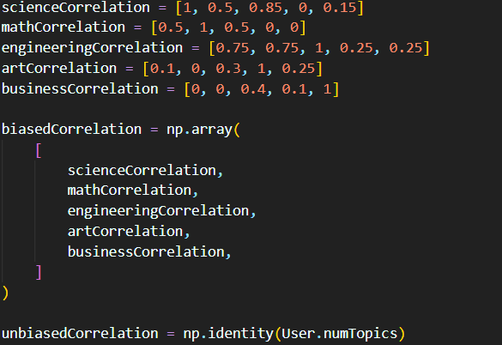
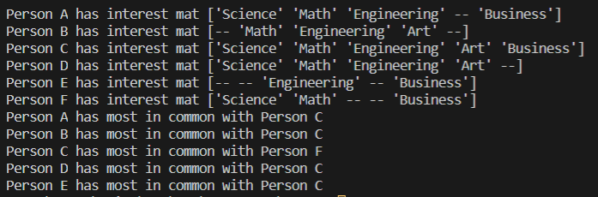
Unbiased Algorithm
Similarly to biased match making, the unbiased algorithm uses the following:
(tag array1).(identity matrix).(tag array2) = compatibility
MSE again is used to rank user and project matches

Slide 13
4. Posting & Account Management
The following features allow users to manage their profiles:
Change username
Change profile picture
Reset account status
Reset password for account
Create new projects or follow other projects
Change post attributes (eg. visible or hidden)

